Slide 1

.NET, OpenAI & Semantic Kernel
Medhat Elmasry

Slide 2
Medhat Elmasry
Instructor at BCIT
Independent Contractor
Microsoft MVP since 2017
Founded .NET BC in 2003
Speaker
https://blog.medhat.ca
medhat@elmasry.ca

Slide 3


Welcome
+
=
Semantic Kernel
You
Innovation

Slide 4




What is Semantic Kernel?
An open-source SDK that lets you easily build agents that call your existing code. As a highly extensible framework, it can be used with models from OpenAI, Azure OpenAI, Hugging Face, and more!
By combining your existing C#, Python, and Java code with these models, you can build agents that answer questions and automate processes.
Python
Java
.Net

Slide 5

AI Agents
AI can solve problems for you. More than just a boring chatbot.
Copilot: Special type of agent that works side-by-side with you
For example: write email, provide suggestions for what to write next
3 main building blocks
Plugin – retrieve information
Planner – plan how to use that information
Persona – respond back to user or perform an action
Plugin
Planner
Persona

Slide 6
Plugins
Group of functions that can be exposed to AI apps and services
Set of instructions or tasks that your app can perform
Flight (Plugin) -> TrackFlight (Functions), BookFlight (Functions)
Semantic description is very important while creating functions
Time
Weather
City
Semantic Kernel
AI Plugins

Slide 7








Semantic or native plugins?
To make a plugin, you'll need to create some functions. These are either semantic or native – you decide.
Time plugin
Native functions
Semantic functions
Endpoint
Semantic Kernel

Slide 8



Planners
Person has a request
A Planner is a function that takes the initial request and returns a list of steps needed to fulfill the request. AI is used to mix-and-match plugins registered in the kernel so it can recombine them into a series of steps.
Semantic Kernel
Plugins
Plan

Slide 9

Personas
Give your agent a personality by providing a sufficient meta-prompt /instruction
Is it friendly? Is it helpful? Is it sarcastic?
Helps us remain within our scope as well
For example, a simple flight tracker wouldn't give you beach suggestions

Slide 10

Apps
Plugin extensibility
At the center of it all is Semantic Kernel
Copilots
AI orchestration
Foundation models
AI infrastructure
S E M A N T I C K E R N E L

Slide 11
Announcement slide (dark) with color rotation
Demo #1:
Sematic Kernel training on GitHub
git clone https://github.com/microsoft/semantic-kernel.git

Slide 12
Announcement slide (dark) with color rotation
Demo #2:
Simple C# completion app with OpenAI and Semantic Kernel Tool

Slide 13
Announcement slide (dark) with color rotation
Demo #3:
Using baking skill in C# console app

Slide 14
Announcement slide (dark) with color rotation
input
FindCity
(Semantic Plugin)
CityInfo
(Native Plugin)
WeatherService
(Native Plugin)
ShortPoem
(Semantic Plugin)
output
API
Demo #4: Planner

Slide 15
Announcement slide (dark) with color rotation
SLMs
efficient
require less computational power and memory
cost-effective
simpler to implement
suitable for smaller projects
quick to deploy
Demo #5: phi3 – SLM (small language models)
https://www.ollama.com/download

Slide 16
Questions?

Slide 17
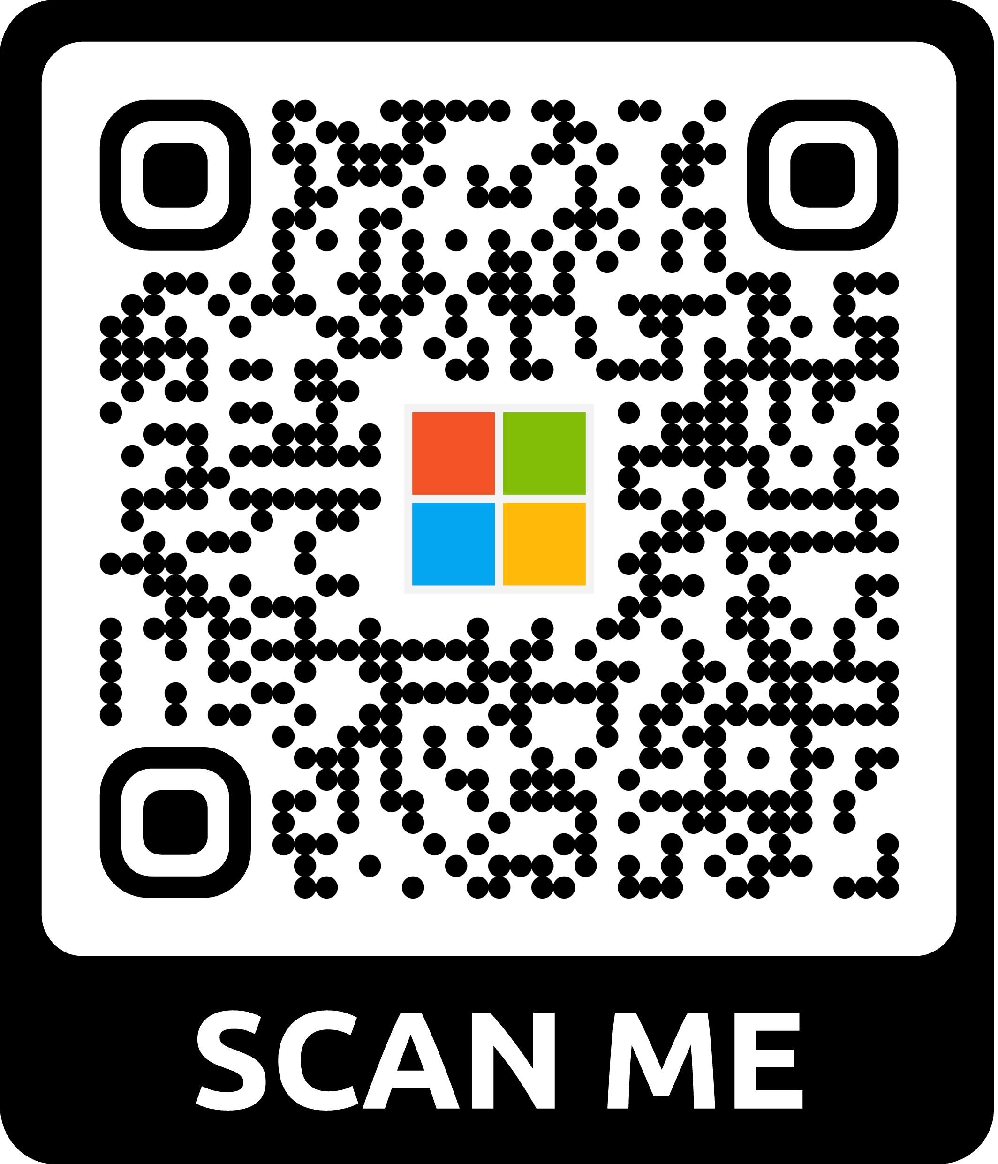
Microsoft wants to hear from YOU!
Attendee Survey
Season of AI | Microsoft Community
2024
User Group Name: .NET User Group of BC
aka.ms/AttendeeSurveySeasonOfAI
Notes:
Remind attendees to participate in the event survey

Slide 18
Thank you

